Slide 1
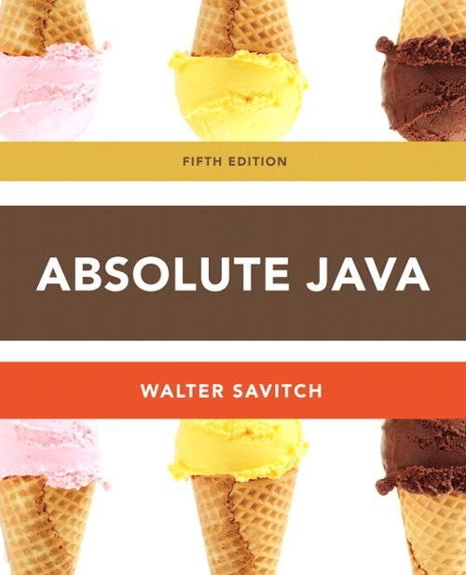
Chapter 3
Debugging
Section 3.4
Slides prepared by Rose Williams, Binghamton University
Kenrick Mock, University of Alaska Anchorage

Slide 2
Loop Bugs
The two most common kinds of loop errors are unintended infinite loops and off-by-one errors
An off-by-one error is when a loop repeats the loop body one too many or one too few times
This usually results from a carelessly designed Boolean test expression
Use of == in the controlling Boolean expression can lead to an infinite loop or an off-by-one error
This sort of testing works only for characters and integers, and should never be used for floating-point

Slide 3
Tracing Variables
Tracing variables involves watching one or more variables change value while a program is running
This can make it easier to discover errors in a program and debug them
Many IDEs (Integrated Development Environments) have a built-in utility that allows variables to be traced without making any changes to the program
Another way to trace variables is to simply insert temporary output statements in a program
System.out.println("n = " + n); // Tracing n
When the error is found and corrected, the trace statements can simply be commented out

Slide 4
General Debugging Techniques
Examine the system as a whole – don’t assume the bug occurs in one particular place
Try different test cases and check the input values
Comment out blocks of code to narrow down the offending code
Check common pitfalls
Take a break and come back later
DO NOT make random changes just hoping that the change will fix the problem!

Slide 5
Debugging Example (1 of 8)
The following code is supposed to present a menu and get user input until either ‘a’ or ‘b’ is entered.
String s = "";
char c = ' ';
Scanner keyboard = new Scanner(System.in);
do {
System.out.println("Enter 'A' for option A or 'B' for option B.");
s = keyboard.next();
s.toLowerCase();
c = s.substring(0,1);
}
while ((c != 'a') || (c != 'b'));

Slide 6
Debugging Example (2 of 8)
Result: Syntax error:
c = s.substring(0,1); : incompatible types
found: java.lang.String
required: char
Using the “random change” debugging technique we might try to change the data type of c to String, to make the types match
This results in more errors since the rest of the code treats c like a char

Slide 7
Debugging Example (3 of 8)
First problem: substring returns a String, use charAt to get the first character:
String s = "";
char c = ' ';
Scanner keyboard = new Scanner(System.in);
do {
System.out.println("Enter 'A' for option A or 'B' for option B.");
s = keyboard.next();
s.toLowerCase();
c = s.charAt(0);
}
while ((c != 'a') || (c != 'b'));
Now the program compiles, but it is stuck in an infinite loop. Employ tracing:

Slide 8
Debugging Example (4 of 8)
do {
System.out.println("Enter 'A' for option A or 'B' for option B.");
s = keyboard.next();
System.out.println("String s = " + s);
s.toLowerCase();
System.out.println("Lowercase s = " + s);
c = s.charAt(0);
System.out.println("c = " + c);
}
while ((c != 'a') || (c != 'b'));
Sample output:
Enter 'A' for option A or 'B' for option B.
A
String s = A
Lowercase s = A
c = A
Enter 'A' for option A or 'B' for option B.
From tracing we can see that the string is never changed to lowercase.
Reassign the lowercase string back to s.

Slide 9
Debugging Example (5 of 8)
The following code is supposed to present a menu and get user input until either ‘a’ or ‘b’ is entered.
do {
System.out.println("Enter 'A' for option A or 'B' for option B.");
s = keyboard.next();
s = s.toLowerCase();
c = s.charAt(0);
}
while ((c != 'a') || (c != 'b'));
However, it’s still stuck in an infinite loop. What to try next?

Slide 10
Debugging Example (6 of 8)
Could try the following “patch”
do {
System.out.println("Enter 'A' for option A or 'B' for option B.");
s = keyboard.next();
s = s.toLowerCase();
c = s.charAt(0);
if ( c == 'a')
break;
if (c == 'b')
break;
}
while ((c != 'a') || (c != 'b'));
This works, but it is ugly! Considered a coding atrocity, it doesn’t fix the
underlying problem. The boolean condition after the while loop has also
become meaningless. Try more tracing:

Slide 11
Debugging Example (7 of 8)
do {
System.out.println("Enter 'A' for option A or 'B' for option B.");
s = keyboard.next();
s = s.toLowerCase();
c = s.charAt(0);
System.out.println("c != 'a' is " + (c != 'a'));
System.out.println("c != 'b' is " + (c != 'b'));
System.out.println("(c != 'a') || (c != 'b')) is "
+ ((c != 'a') || (c != 'b')));
}
while ((c != 'a') || (c != 'b'));
Sample output:
Enter 'A' for option A or 'B' for option B.
A
c != 'a' is false
c != 'b' is true
(c != 'a') || (c != 'b')) is true
From the trace we can see that the loop’s boolean expression is true because c
cannot be not equal to ‘a’ and not equal to ‘b’ at the same time.

Slide 12
Debugging Example (8 of 8)
Fix: We use && instead of ||
do {
System.out.println("Enter 'A' for option A or 'B' for option B.");
s = keyboard.next();
s = s.toLowerCase();
c = s.charAt(0);
}
while ((c != 'a') && (c != 'b'));

Slide 13
Assertion Checks
An assertion is a sentence that says (asserts) something about the state of a program
An assertion must be either true or false, and should be true if a program is working properly
Assertions can be placed in a program as comments
Java has a statement that can check if an assertion is true
assert Boolean_Expression;
If assertion checking is turned on and the Boolean_Expression evaluates to false, the program ends, and outputs an assertion failed error message
Otherwise, the program finishes execution normally

Slide 14
Assertion Checks
A program or other class containing assertions is compiled in the usual way
After compilation, a program can run with assertion checking turned on or turned off
Normally a program runs with assertion checking turned off
In order to run a program with assertion checking turned on, use the following command (using the actual ProgramName):
java –enableassertions ProgramName
assert (n != 0);
average = sum / n;

Slide 15
Preventive Coding
Incremental Development
Write a little bit of code at a time and test it before moving on
Code Review
Have others look at your code
Pair Programming
Programming in a team, one typing while the other watches, and periodically switch roles

